Slide 1
Rancher to Manage Kubernetes
ICT Precedent Development Group
2022.05.23

Slide 2
Install dockerized Rancher on Linux Machine
Use below commands to install dockerized Rancher
# docker run -d --restart=unless-stopped -p 80:80 -p 443:443 -e CATTLE_BOOTSTRAP_PASSWORD=SoluM201509! --privileged rancher/rancher:latest

Slide 3
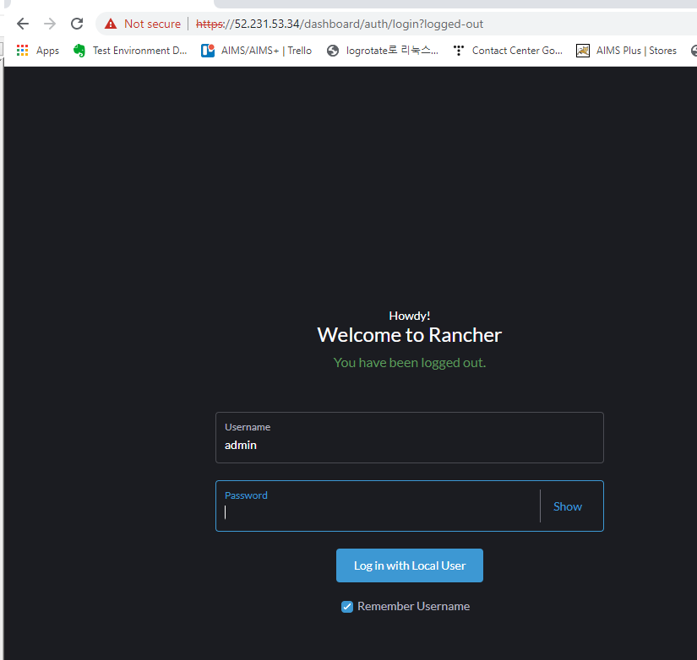
Install dockerized Rancher on Linux Machine
Use below URL and authentication to login to Rancher’s dashboard.
https://52.231.53.34/
admin/SoluM201509!

Slide 4
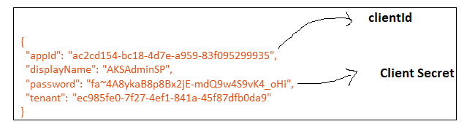
Register existing Azure Kubernetes on Rancher’s Dashboard
We must provide Azure’s authentication to Rancher in order to access Azure’s Kubernetes for a specific subscription
Use below command on Azure Cloud Shell
Subscription: solumesl01
SubscriptionId: 888464c6-6e6c-41f1-b6f2-e247a4403e8f
# docker run -d --restart=unless-stopped -p 80:80 -p 443:443 -e CATTLE_BOOTSTRAP_PASSWORD=SoluM201509! --privileged rancher/rancher:latest
Output:
# az ad sp credential list --id ac2cd154-bc18-4d7e-a959-83f095299935 --query "[].endDate" -o tsv
Output:
2023-05-20T21:10:52.283396+00:00 -> 1 year expiry2023-05-20T21:10:52.283396+00:00 -> 1 year expiry

Slide 5
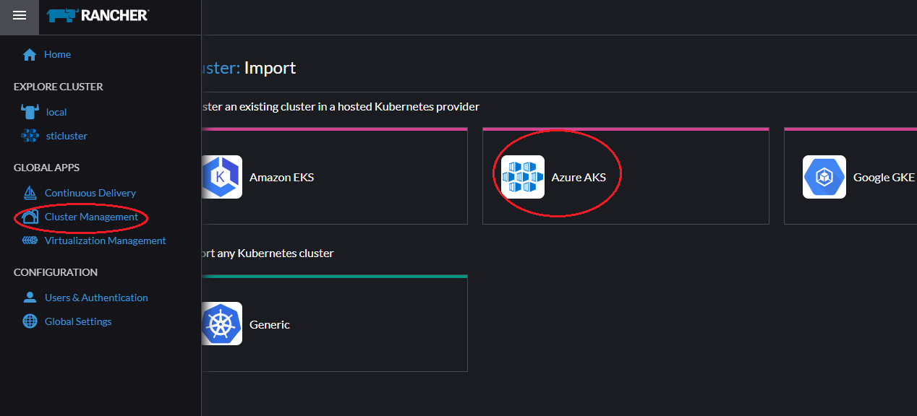
Register existing Azure Kubernetes on Rancher’s Dashboard
We must choose the type of cluster as Azure AKS for our case.

Slide 6
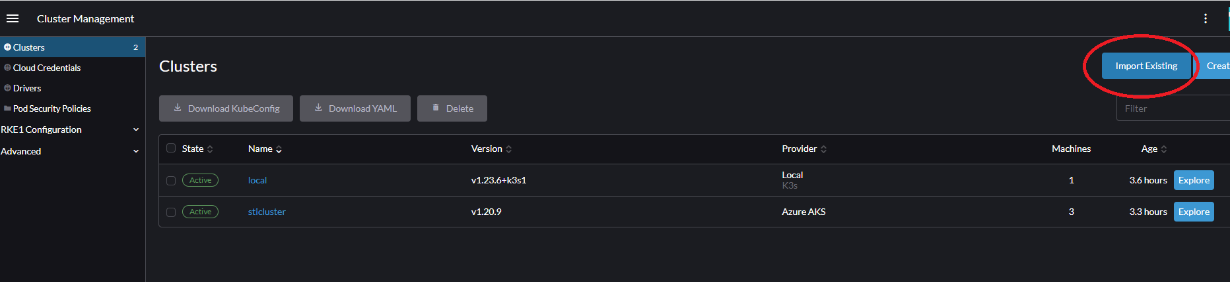
Register existing Azure Kubernetes on Rancher’s Dashboard
We must choose “Import Existing”

Slide 7
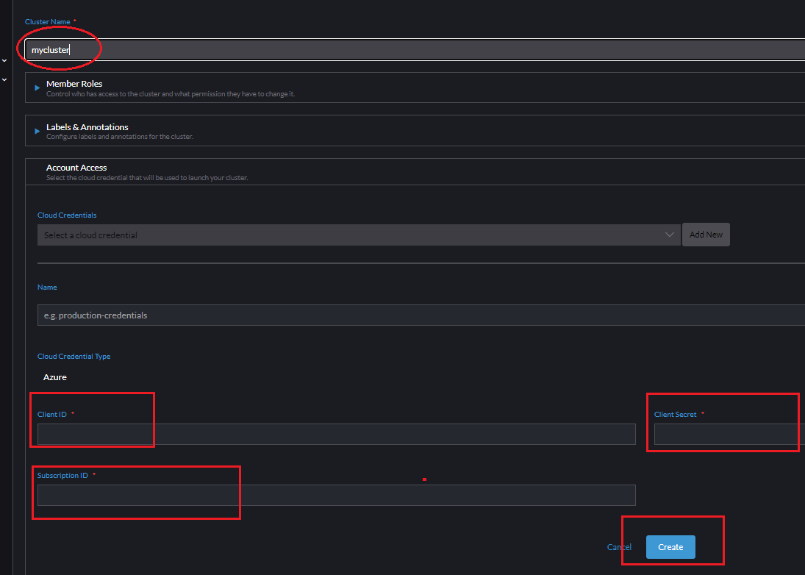
Register existing Azure Kubernetes on Rancher’s Dashboard
Add previously created credential details in slide-4

Slide 8
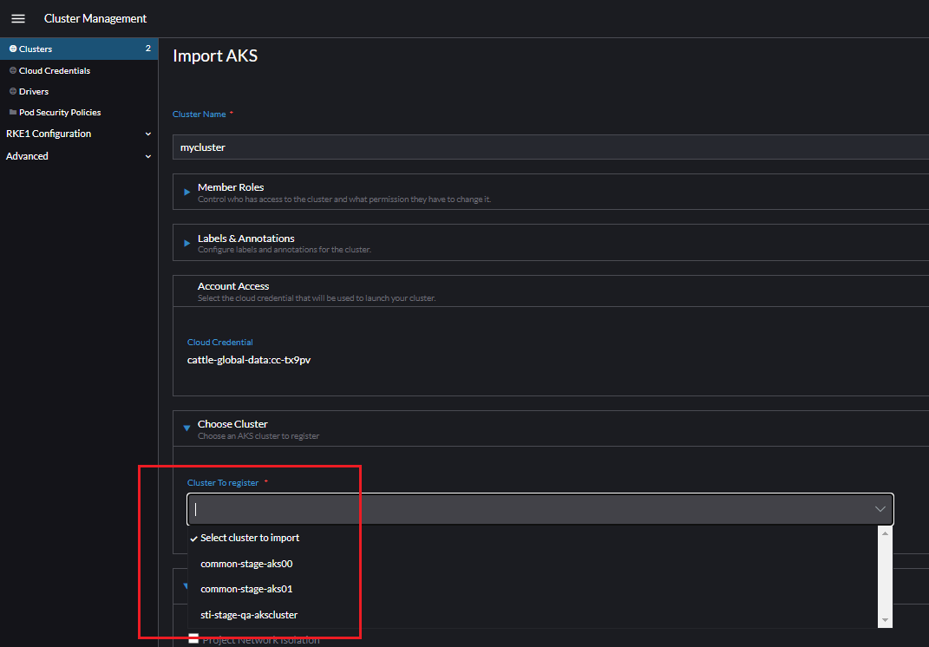
Register existing Azure Kubernetes on Rancher’s Dashboard
Choose the cluster name to add.

Slide 9
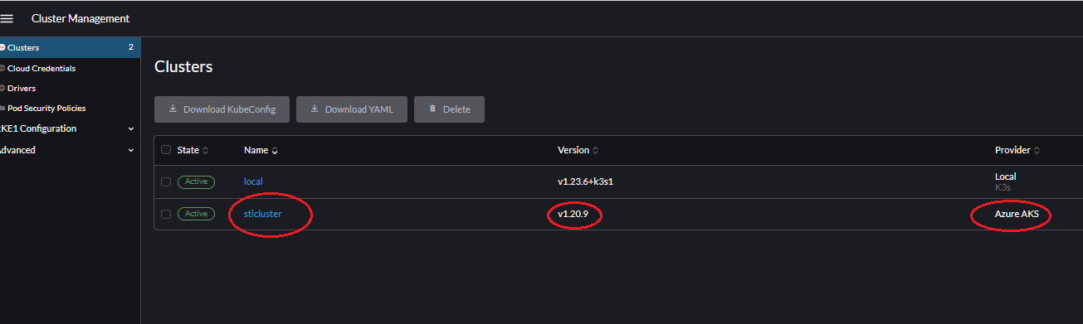
Register existing Azure Kubernetes on Rancher’s Dashboard
Choose the cluster name to add.

Slide 10
Check pod’s live logs from Rancher’s dashboard
Checking pod’s live logs

Slide 11
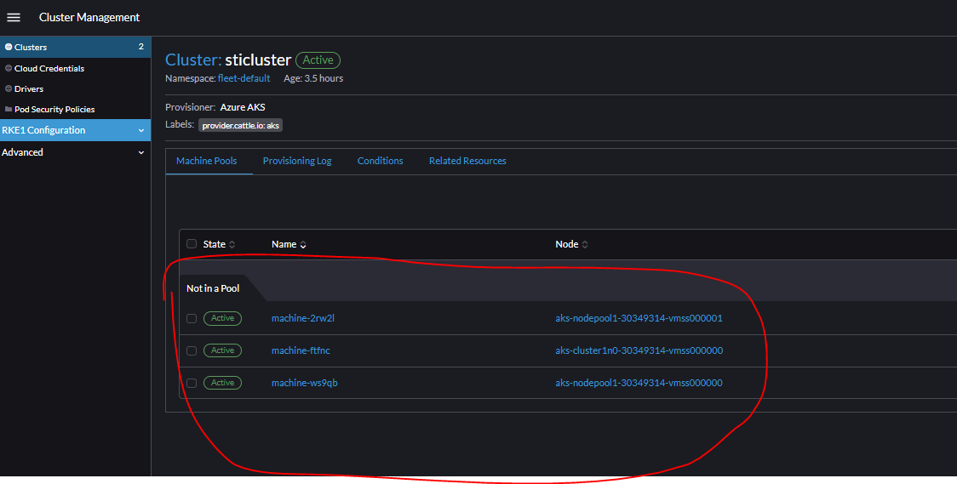
Check pod’s live logs from Rancher’s dashboard
Pod’s live logs

Slide 12
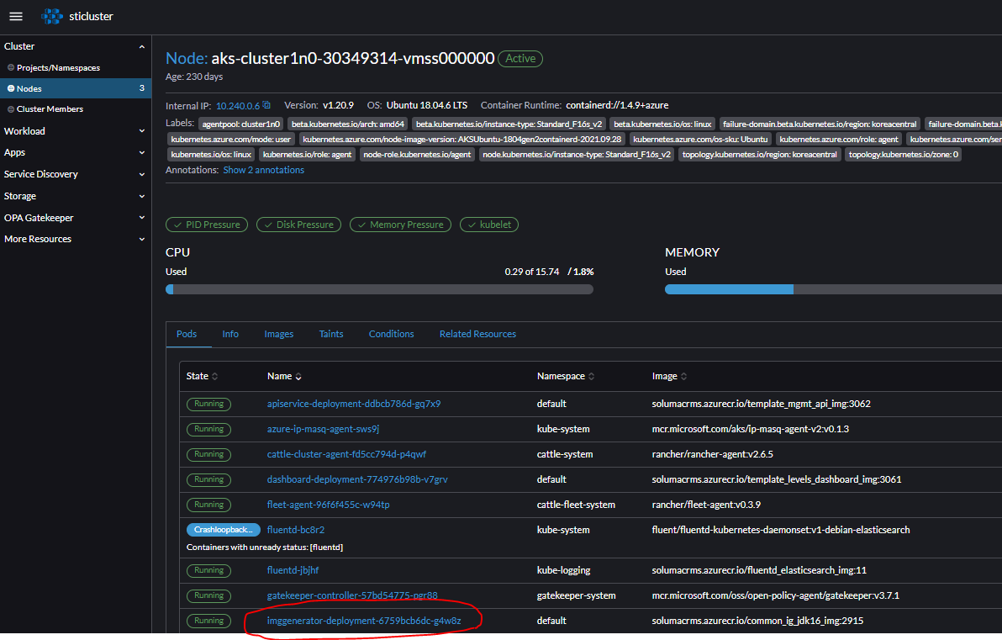
Check pod’s live logs from Rancher’s dashboard
Pod’s live logs

Slide 13
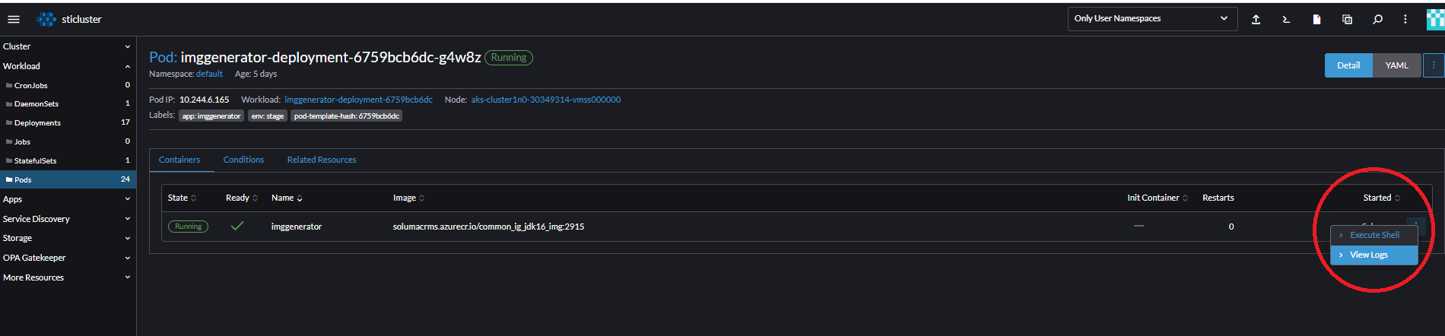
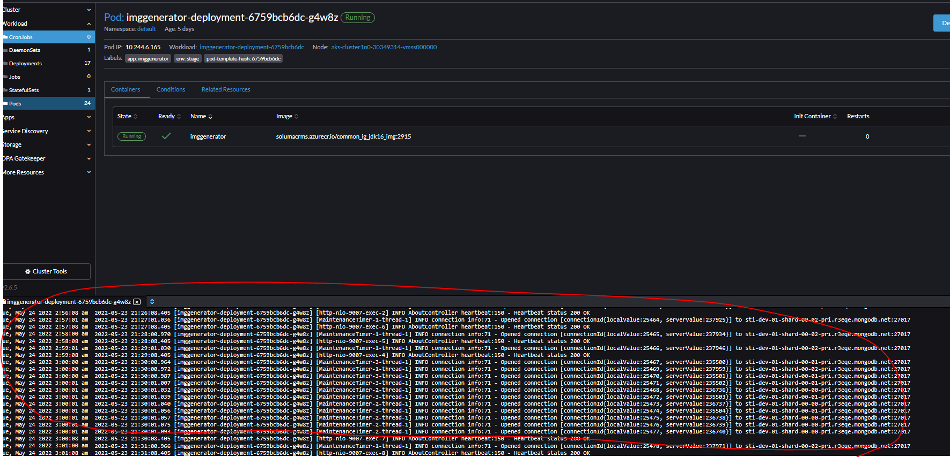
Check pod’s live logs from Rancher’s dashboard
Pod’s live logs

Slide 14

THANK YOU

